Slide 1
Experimental laboratories enhancing the safety and security in control systems course
Academic Teacher Training Course I
Pedagogical Project
Anh Tung Nguyen
PhD student
Department of Information Technology, Uppsala University
anh.tung.nguyen@it.uu.se

Slide 2
Outline
Background and motivation
Goal
Methodological approach
Assessments
Analytical discussion
Conclusion

Slide 3
1. Background and motivation
Group of courses on control systems (what?)
Unwanted accidents, unfortunate events, hackers’ intention
Safety and Security are essential
IT-Dept. organizes “Safety and Security in Control Systems”
Analyze/Evaluate/Mitigate/Prevent such faults/attacks
Mathematical description (theories) and numerical evaluation (software simulation)
Difficulties: What are faults/attacks in real-world systems? How serious are their consequences?

Slide 4
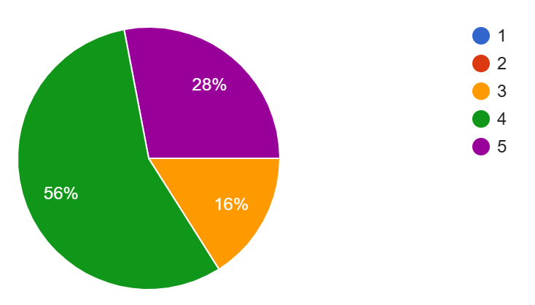
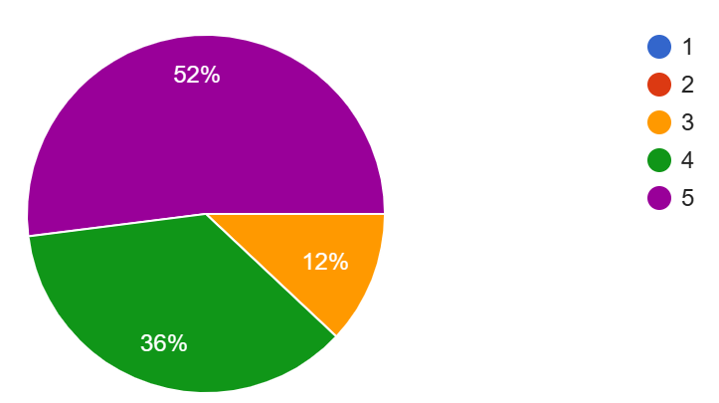
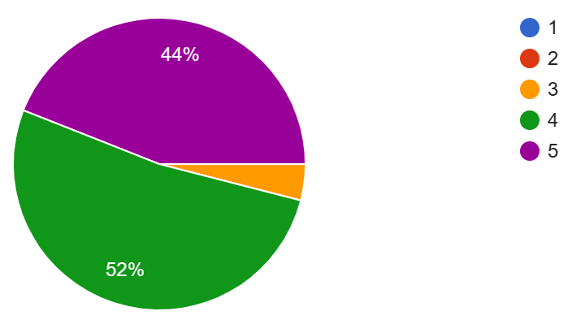
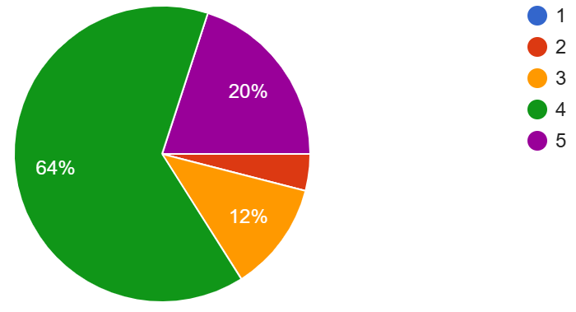
1. Background and motivation (Cont.)
25 responses in a process lab
Did your interest in the subject matter increase as the instructor taught?
Did you enjoy this lab?
Did this lab teach you things you need to know?
Self-assessment your contribution to the group work.

Slide 5
1. Background and motivation (Cont.)
Students’ feedback
The LQG lab was also one of the most fun labs I have participated in during these years in university!
The labs were also very good in providing applied theory as well as some practical work which is always appreciated
The lab was very fun
the lab was great because it made things practical and understandable so that one will remember it.

Slide 6
2. Goal
Inspired by other courses at UU with practical exercises
Fill the gap between theories and practices through process labs
Implementation, analysis, and evaluation of faults/attacks
Intended learning outcomes
Students understand operation of real systems
Students apply control schemes to real systems
Students perform and analyze faults/attacks in real systems
Student evaluate fault/attack detection algorithms

Slide 7
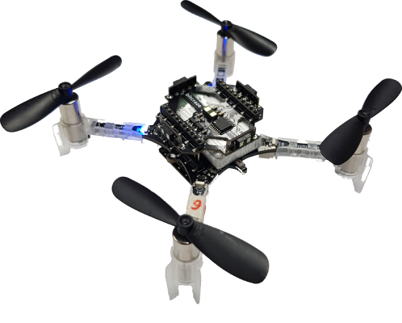
3. Methodological approach
Two processes labs (4 hours for each) + 2 hours preparation
An educational experimental system (originally developed in Sweden)
Verify novel methods quickly and scale up to large-size drones easily

Slide 8

3. Methodological approach
What can Crazyflies do?

Slide 9
3. Methodological approach (Cont.)
Teaching and Learning Activities
First Preparation (1 hour)
Students understand drones setup, how it works, which parts they can use
First lab (4 hours) – Students as hackers
Students apply suitable control techniques to drones
Students perform faults/attacks (sensor faults, actuator faults, denial-of-services attacks, false data injection attacks)
Students analyze the consequences of such faults/attacks

Slide 10
3. Methodological approach (Cont.)
Teaching and Learning Activities (Cont.)
Second preparation (1 hour)
From analysis to decision
Second lab (4 hours) – Students as defenders
Students present reasons of their choices to instructors
Students perform the detection method and analyze the advances
Students secure drones at least one faulty cases in the first lab

Slide 11
4. Assessment
The two labs are compulsory to pass the course
Oral examination and Hand-in
The two preparations: Students are required to submit their answers to Studium two days before the corresponding labs
The two process labs: oral examination
First lab: Explain meaning of faults/attacks, explain how to implement faults/attacks, analyze and evaluate consequences
Second lab: Suitable reasons of their choices, explain how to implement detection, analyze and evaluate detection schemes, secure drones at least one faulty case.

Slide 12
5. Analytical discussion
Hackers:
Motivate parameters related to practical situation
How long do drones crash from the presence of faults/attacks
Defenders:
Motivate parameters related to hardware constraints
How long does the method detect faults/attacks
How to tune parameters to secure drones

Slide 13
6. Conclusion
Fill the gap between theories and practices
Students do apply, analyze, and evaluate methods
Raise awareness of safety in control systems
Beneficial to both academia-oriented and industry-oriented students

Slide 14
Thanks for your attention!!! QnA

